Slide 1
Type and Typography

Slide 2
What is type?
Type is available in all digital design software packages and gives the designer many creative possibilities—illustrating with type, setting type in perfect proportion to the page, using special effects on type.

Slide 3
Type Categories
Serif typefaces
Sans serif
Script and cursive
Black letter
Decorative
Symbol

Slide 4
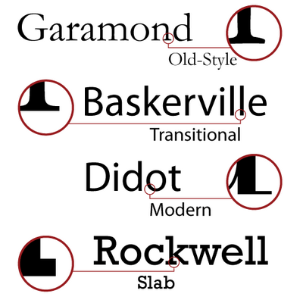
Serif typefaces
Serif typefaces have tails (cross lines) at the top and bottom ends of the letter strokes.

Slide 5
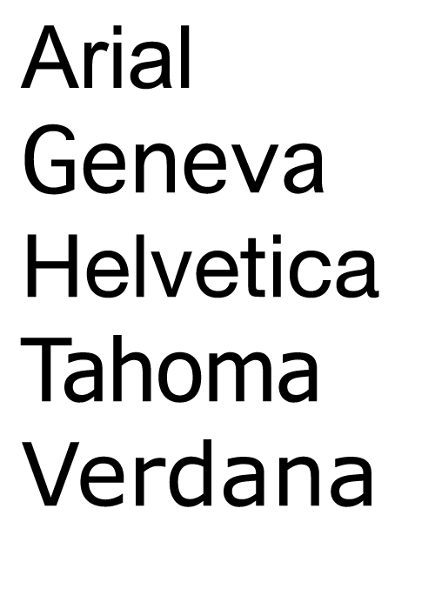
Sans serif
Sans serif typefaces’ characters without serif have a modern, industrial style.

Slide 6
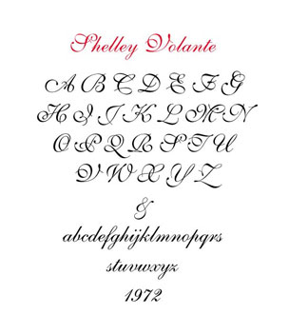
Script and cursive
Script and cursive typefaces are designed to look like handwriting and can provide a composition with elegance if used properly.

Slide 7
Black letter
Black letter typefaces are also known as gothic or text letter fonts. They imitate the appearance of calligraphic letters and can give composition some Old English style.

Slide 8
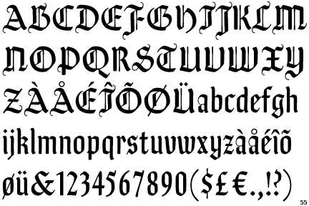
Black letter

Slide 9
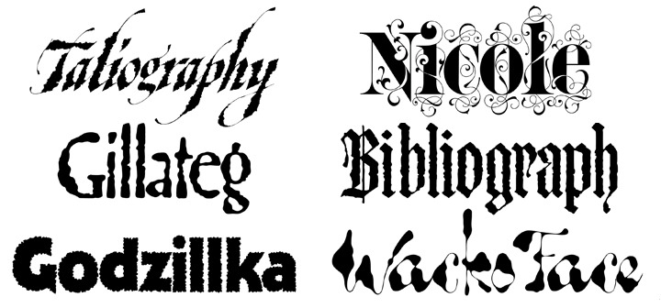
Decorative
Decorative typefaces are fonts with abstract or elaborate letters that create a look of novelty.

Slide 10
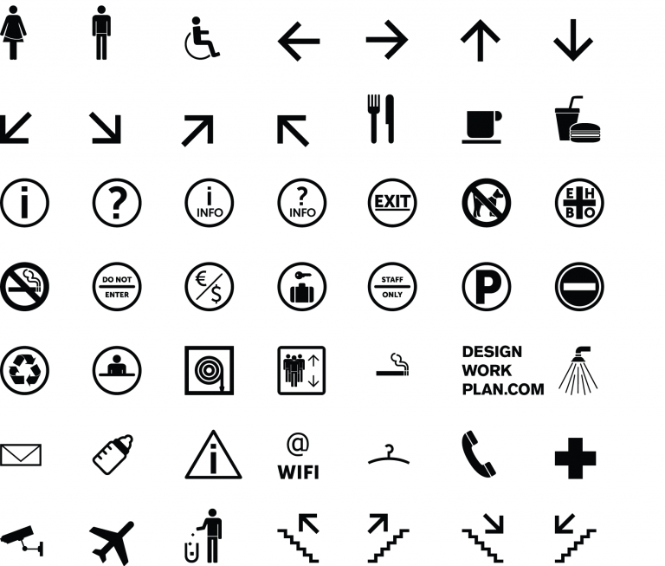
Symbol
Symbol typefaces are geometric figures and illustrations.

Slide 11
What is Typography？
Typography is the art of arranging letters and text in a way that makes the copy legible, clear, and visually appealing to the reader.
Typography involves font style, appearance, and structure, which aims to elicit certain emotions and convey specific messages.

Slide 12
Getting Attention and Delivering Clarity
Typography is the manipulation of type and space.
Readability and legibility are the cornerstones of good typography.

Slide 13
Getting Attention and Delivering Clarity
Typography uses visual language in the form of letters, words, sentences, and paragraphs to thoughtfully present a message within a composition.

Slide 14
Getting Attention and Delivering Clarity
Typography is the technique used to simplify and clarify messages so the reader can extract as much meaning as possible.

Slide 15
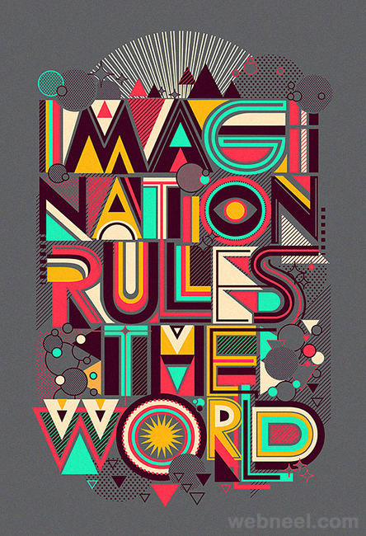
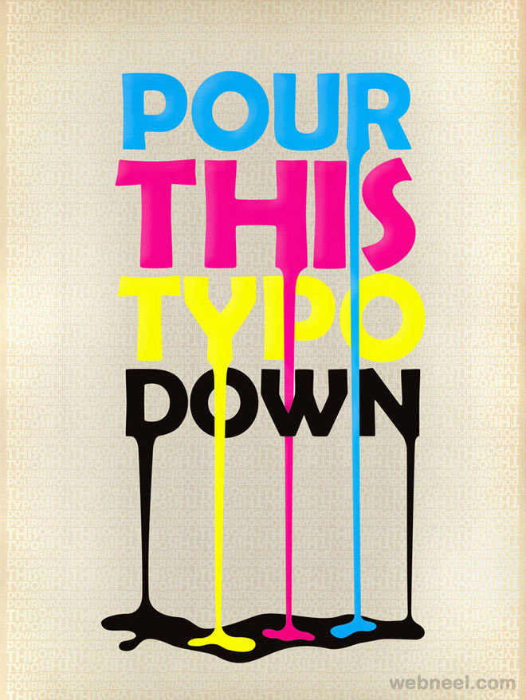
Getting Attention and Delivering Clarity

Slide 16
Getting Attention and Delivering Clarity
This requires the designer to read and understand the message so he or she can act as a visual translator, synthesizing the information provided into a representation using words and images.

Slide 17
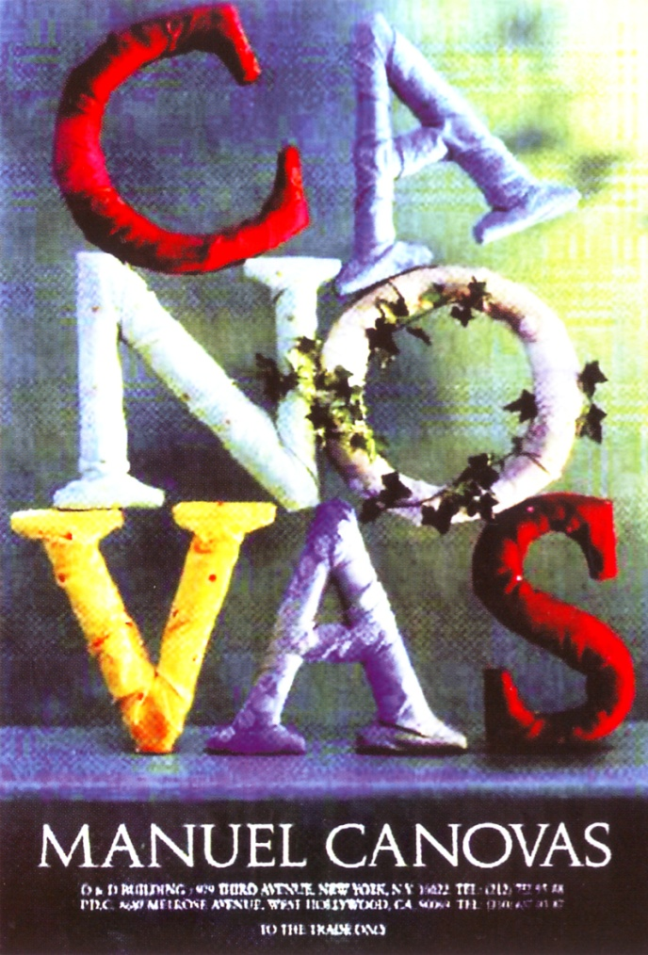
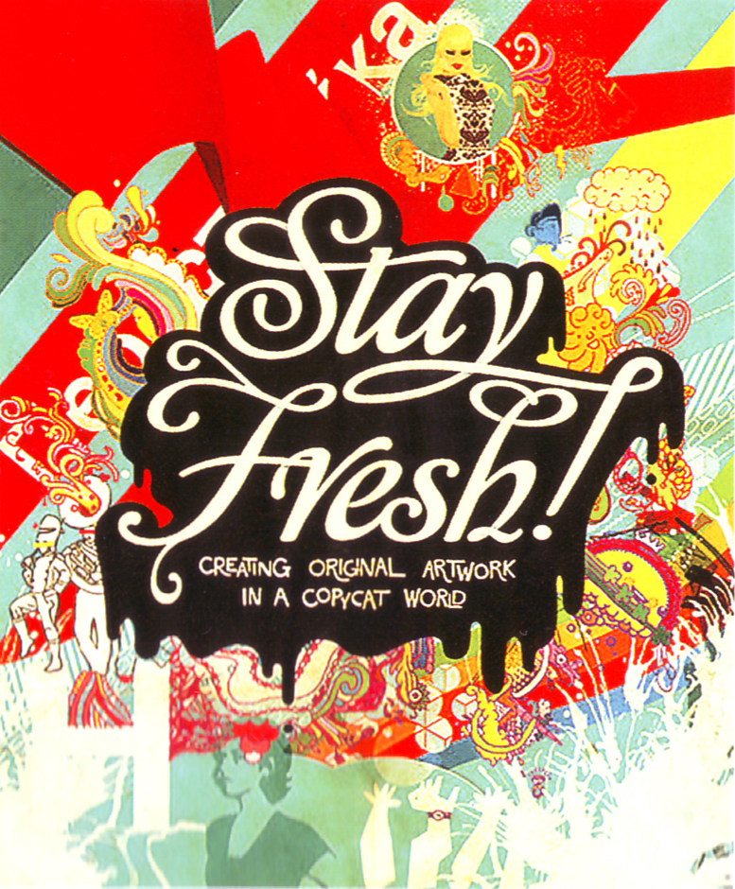
Getting Attention and Delivering Clarity

Slide 18
Getting Attention and Delivering Clarity
Choosing the proper typefaces can convey the proper mood and emotion for representing a design’s theme.

Slide 19


Examples

Slide 20

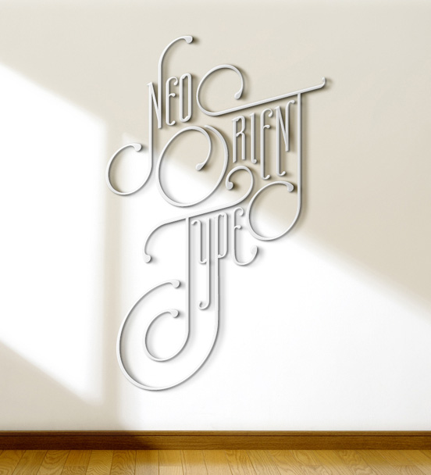
Examples

